Slide 1
V1 AMiON Tab App – High Level Scenarios
As a team owner, I need to provide my clinical team with on-call information and chose which information to show
As a clinician, I need to understand who is currently on-call and who will be on call in the future for all groups within the hospital
As a clinician, I need to contact an on-call resource via Teams
As a clinician, I need to reach out to an on-call resource via another modality that is not Teams (call, text to page)

Slide 2
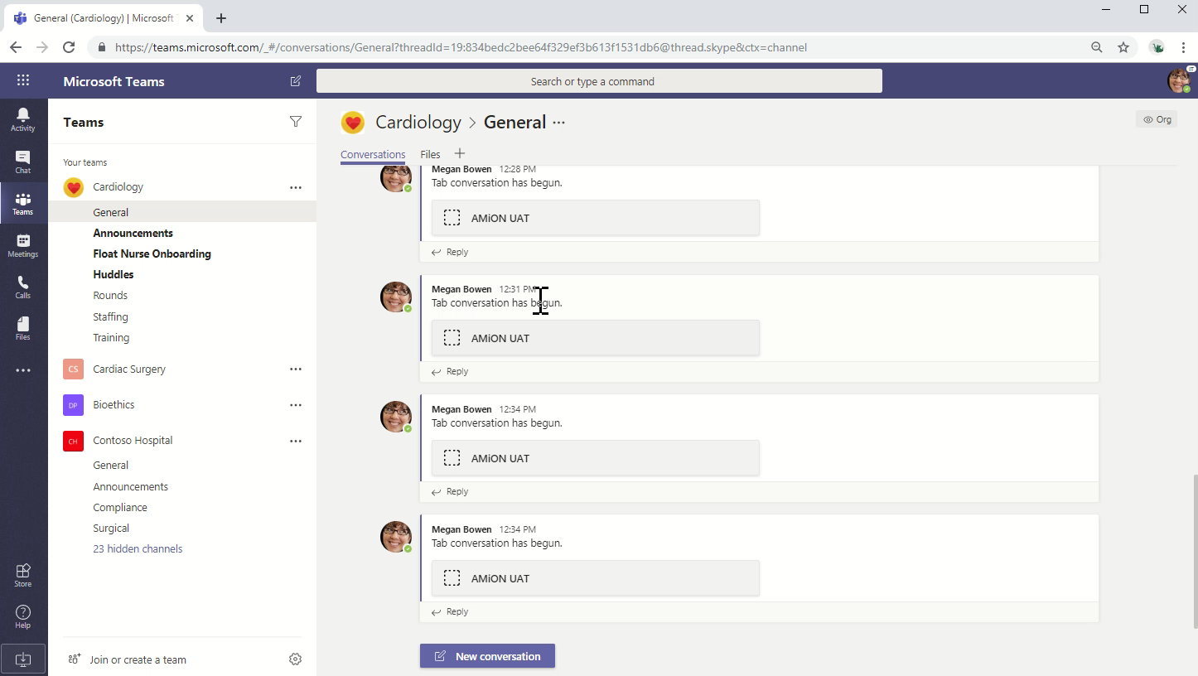
V1 - DEMO

Slide 3
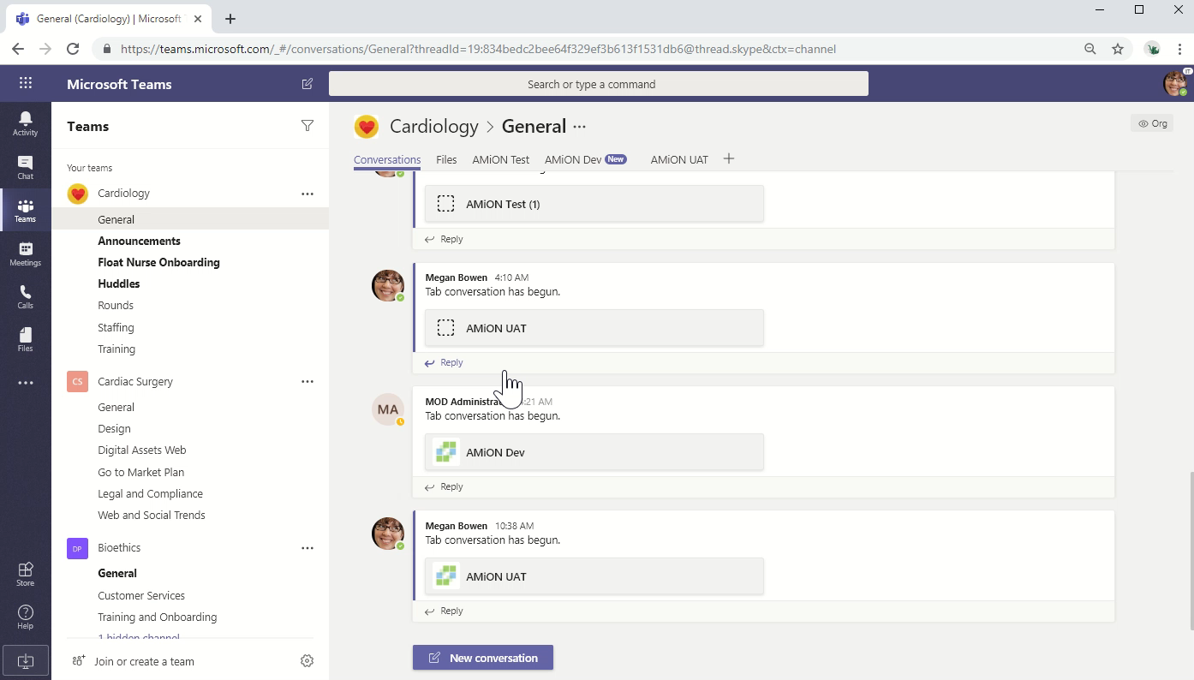
Text to Page

